Slide 1
Autonomous Flag Finder
Burnout Squad
Jeremiah McCutcheon: Project Manager
David Koblah: Hardware Design
Michael Bates: Software Design

Slide 2
System Description
This system is an autonomous robot designed to locate, identify and retrieve flags inside a room or maze.
It will utilize a camera and proximity sensors to navigate its environment.
The camera will wirelessly communicate with a computer in order to identify flags and retrieve them.
A microcontroller will control the movement of the tank, proximity sensors and servo motors to rotate the camera or retrieve the flags.
David Koblah

Slide 3
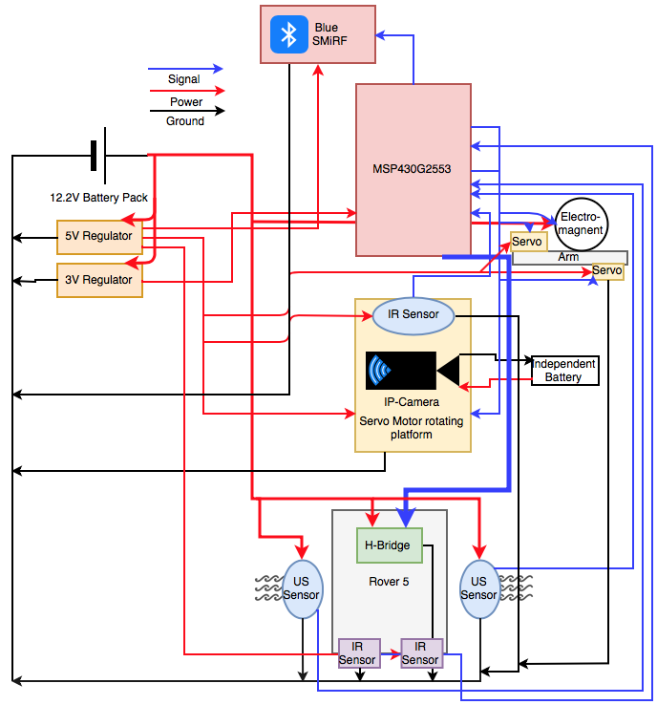
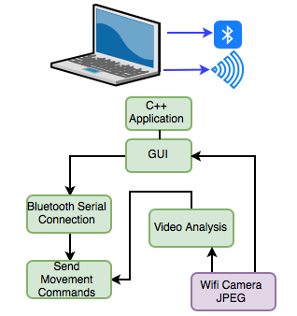
System Diagram
David Koblah

Slide 4
Division of labor
Jeremiah: Bluetooth Serial Communication Interface with Mac, Video Camera Interface with Mac, Image Processing
David: BlueSMiRF receiving communication, Servo arm and Electromagnet interface, Flag Collection
Michael: Analog IR sensor implementation, Autonomous Navigation, MSP430 Code Interface, PCB, Budget
Jeremiah McCutcheon

Slide 5
Safety Concerns
Our primary safety concern this week has been managing the 9.6V battery to avoid any fires and over volting microcontroller circuits. We may also add a warning signal to our design to prevent fellow lab users from running into the rover.
Making sure not to connect to TTU with lab router.
Wearing appropriate Personal Protective Equipment
Pants
Closed Toed Shoes
Safety Glasses
Making sure to perform all painting OFF campus.
David Koblah

Slide 6
Last Week’s Deliverables
Jeremiah
Complete Blob Detection ✅
Write ‘Blob Mode’ Code✅
Michael & David
Interface Servo Arm and Electromagnet Code with Sensor Navigation Code 😵50%
Run Tests with Sensor Movement and Servo Arm 👎
Finalize power distribution for the entire system ✅
Jeremiah McCutcheon

Slide 7
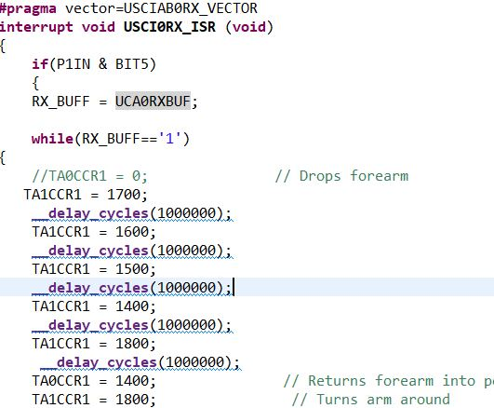
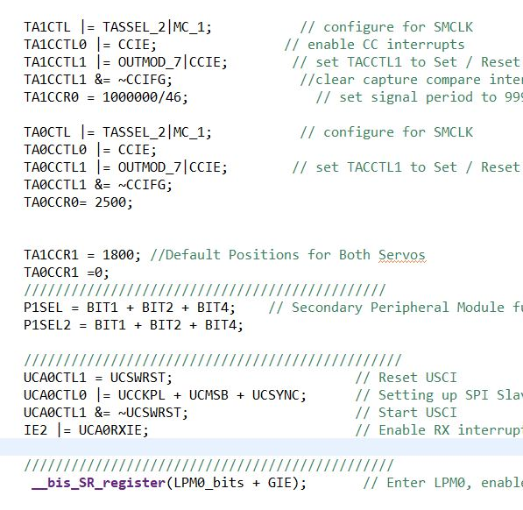
Robot Arm Slave Code Using SPI
David Koblah

Slide 8
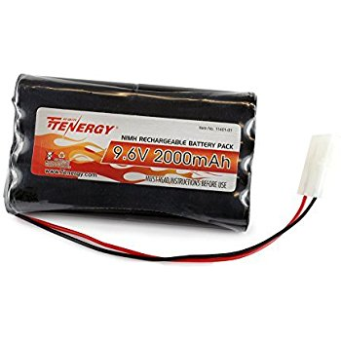
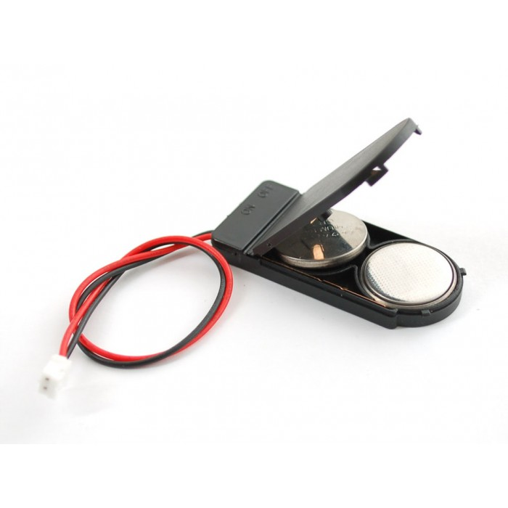
Power Solution For Flag Finder System
9.6V 2000mAh Pack [2]
Coin Battery Holder [1]
Will power Rover and be regulated to power Robot Arm
Will power Bluetooth modules on Flag Finders
David Koblah

Slide 9
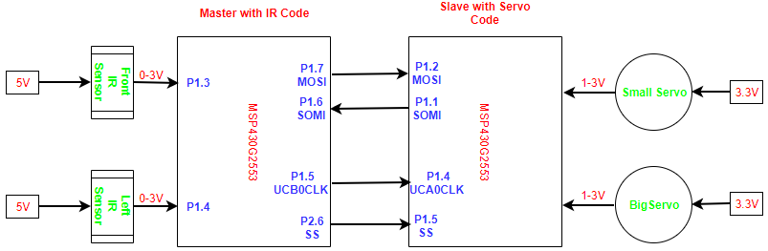
Serial Peripheral Interface (SPI)
Drawio.com [3]
Michael Bates

Slide 10
Navigation Test Video
Michael Bates

Slide 11
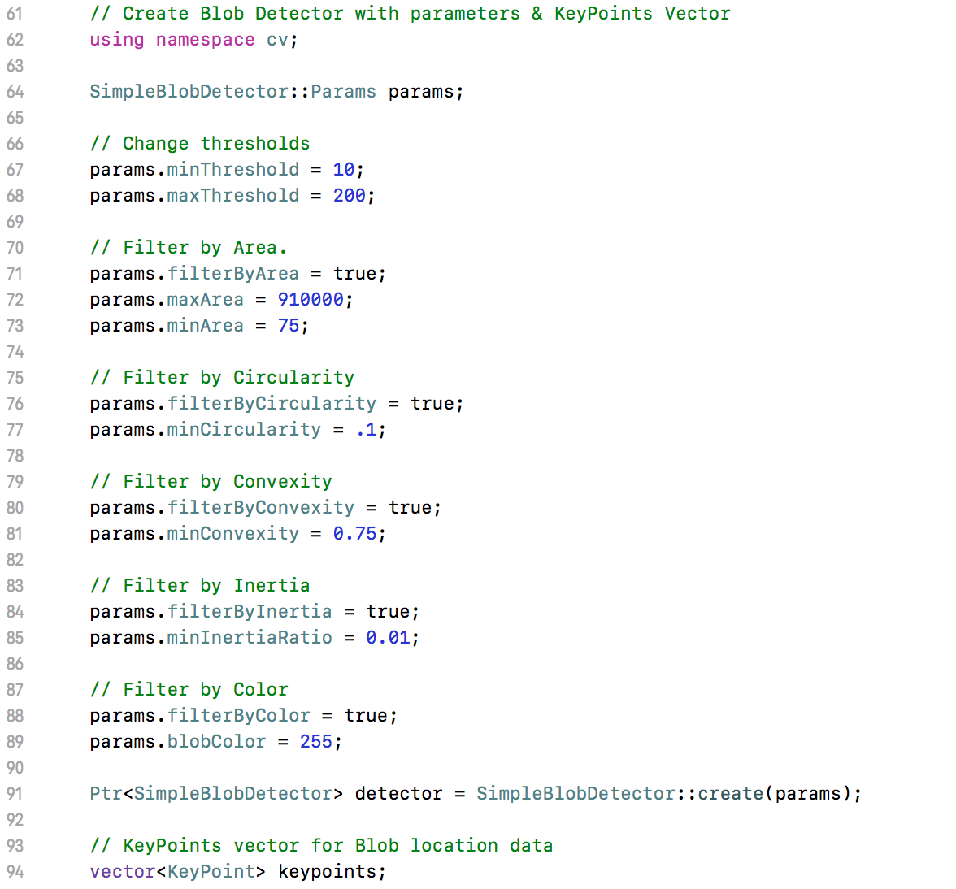
Blob Detection
Blob Parameters
Establish cv namespace &
Create parameter data structure
Create new blob detector object & KeyPoint vector
Jeremiah McCutcheon
Blob Parameters [4]

Slide 12
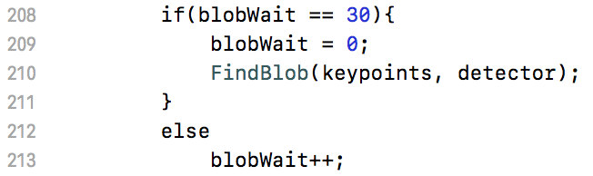
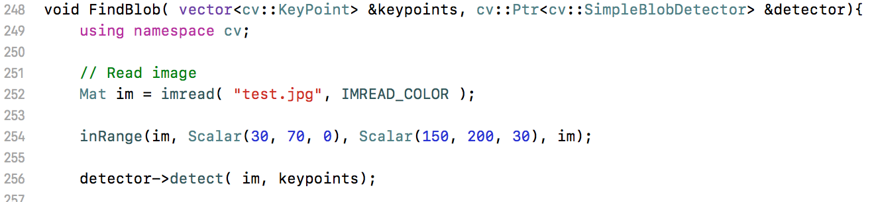
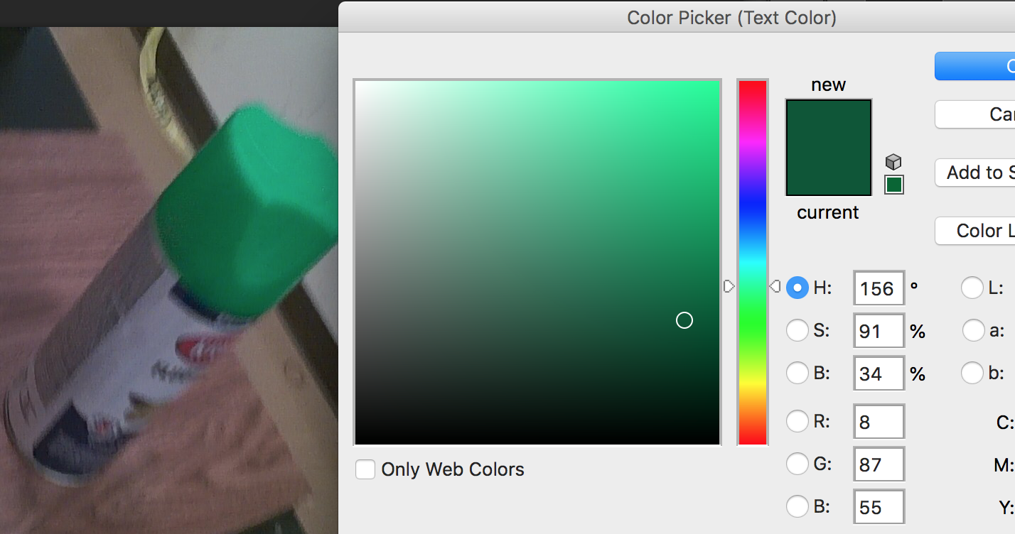
Blob Detection
Run blob detection
Isolate Green
Jeremiah McCutcheon
inRange function opencv [5]

Slide 13
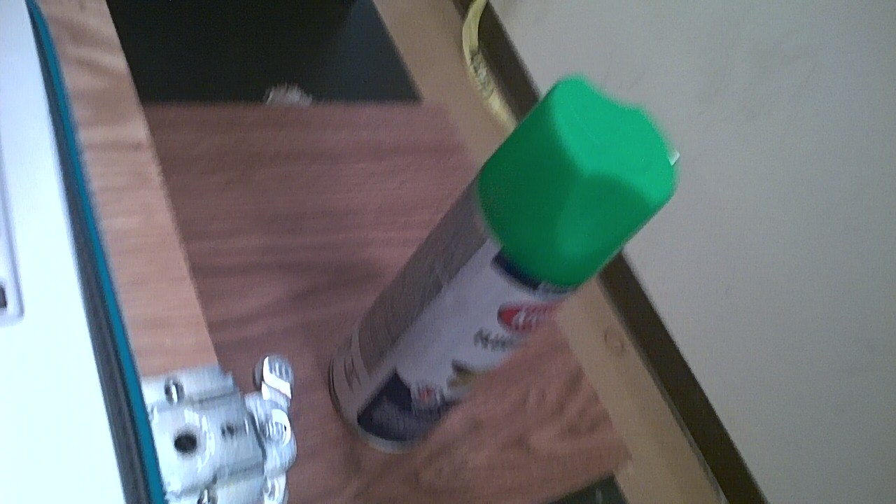

Blob Detection
Original
Green Isolated
Jeremiah McCutcheon

Slide 14
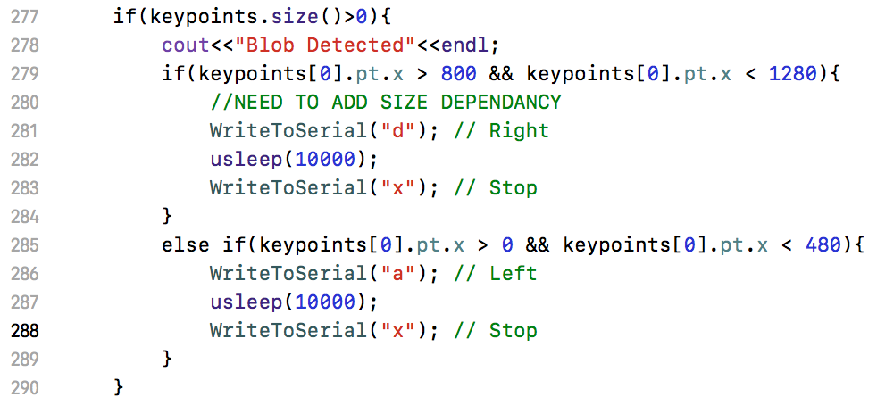
‘Blob Mode’
Blob location on image
Jeremiah McCutcheon
inRange function opencv [5]

Slide 15
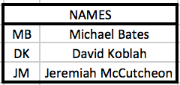
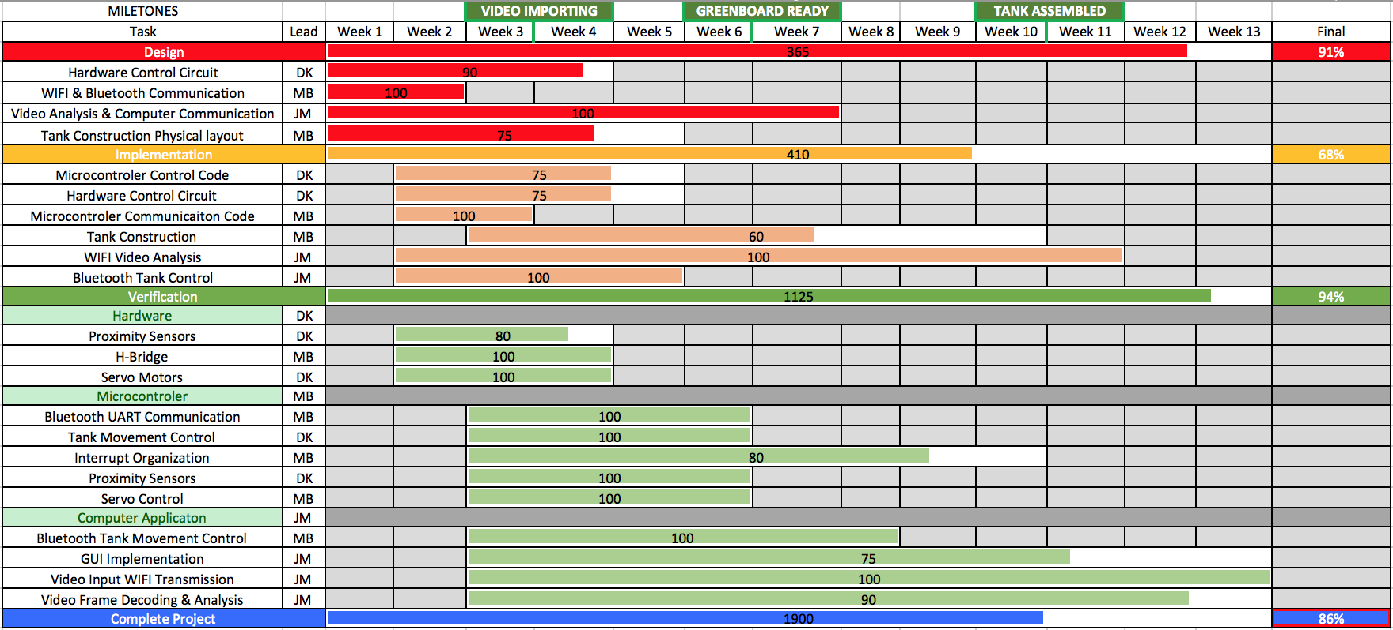
Gantt Chart
Jeremiah McCutcheon

Slide 16
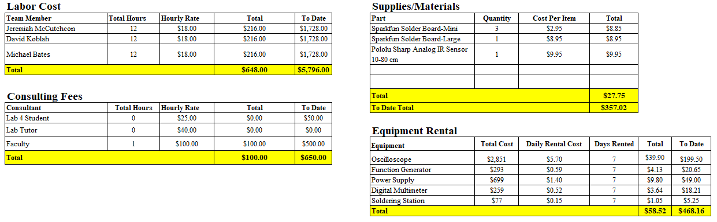
Budget
Excel [6]
Michael Bates

Slide 17
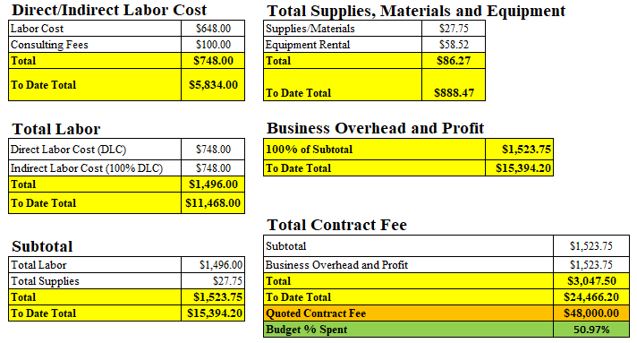
Budget Continued
Michael Bates
Excel [6]

Slide 18
Next Week’s Deliverables
Jeremiah
Flag Retrieval test
RSSI with all 4 Blue SMiRF’s
Michael & David
Finish Integrating Servo Arm and Electromagnet Code with Sensor Navigation Code
Run Tests with Sensor Movement and Servo Arm
David Koblah

Slide 19
References
[1] Robotpark- http://www.robotpark.com/2x2032-Coin-Cell-Battery-Holder-6V-output-with-On-Off-switch
[2] Amazon- https://www.amazon.com/Tenergy-Standard-Connector-Security-Rechargeable/dp/B001BA292A
[3] drawio.com
[4] Blob parameters opencv: https://www.learnopencv.com/blob-detection-using-opencv-python-c/
[5] InRange function opencv: https://stackoverflow.com/questions/38082004/opencv-inrange-function
[6]Microsoft Excel
Michael Bates

Slide 20
Questions?

